Slide 1

Insert, Update, Delete, Transactions
M2-D4
Participate! The more engagement the better! You are NEVER interrupting me!

Slide 2
Objectives
Inserting Data (INSERT)
Updating Data (UPDATE)
Deleting Data (DELETE)
Constraints and referential integrity
Transactions

Slide 3
Database Operations
CRUD represents an acronym for the database operations Create, Read, Update, and Delete.
C - Create (INSERT)
R - Read (SELECT)
U - Update (UPDATE)
D - Delete (DELETE)

Slide 4
INSERT
Adds a new row of data to a table
INSERT INTO table_name (column1, column2, ..., column_n) VALUES (value1, value2, ... value_n);
Example:
INSERT INTO countrylanguage (countrycode, language, isofficial, percentage)
VALUES ('USA', 'Klingon', false, 99);
If you are going to insert into every column you can omit the column names.
INSERT INTO table_name VALUES (value1, value2, ... value_n);

Slide 5
UPDATE
Updates the value of columns on an existing row of data for the specific rows.
UPDATE table_name SET column = value WHERE column = value;
Can update multiple columns in a single update statement.
UPDATE table_name SET column1 = value1, column2 = value2 WHERE column = value;
UPDATE country
SET capital = 3796
WHERE code = 'USA';
UPDATE country
SET capital = 3813, headofstate = 'Mickey Mouse'
WHERE code = 'USA'

Slide 6
DELETE
Deletes row(s) of data from a table.
DELETE FROM table_name WHERE column=value;
Use caution: I recommend you test that your where condition is correct using a SELECT before deleting.

Slide 7
UPDATE/SELECTS
Sometimes you may not know the id’s at the time you need to do the update. You could use a select statement within an update (or insert) and pull the id or fields needed into your update statement
-- 5. Assign the Mathmagical category to the following films, "Euclidean PI",
-- "EGG IGBY", "KARATE MOON", "RANDOM GO", and "YOUNG LANGUAGE"
UPDATE film_category
SET category_id = (SELECT category_id FROM category WHERE category.name = 'Mathmagical')
WHERE film.title in ('EGG IGBY', 'RANDOM GO','YOUNG LANGUAGE','KARATE MOON')

Slide 8
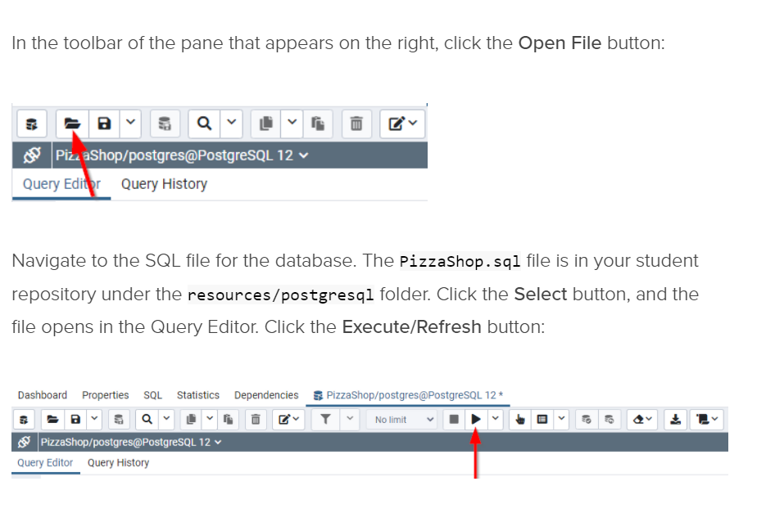
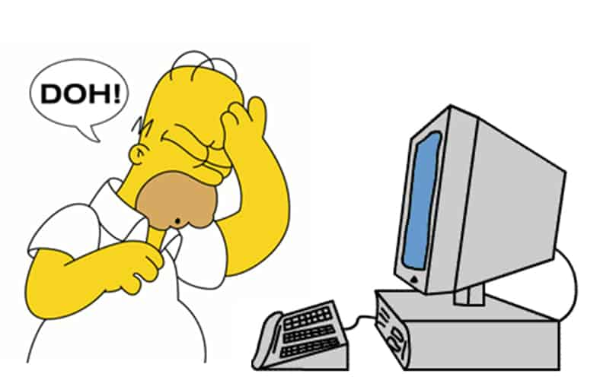
HOW TO DROP A DB IF YOU MESS UP:
In PgAdmin, right click on the database you want to reload and open Query tool
Follow the steps in the image below:

Slide 9
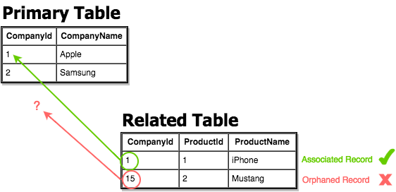
Referential Integrity
Referential Integrity is a property of the data stating whether or not references within it are valid. For example, to use a foreign key on a table, the value must exist on the primary table. Referential integrity refers to the accuracy and consistency of data within a relationship.

Slide 10
Constraints
A constraint on a table defines properties that the column data must comply with. It sets a rule that must be obeyed to maintain the integrity of the data. Constraints are what ensures referential integrity.
NOT NULL | The column cannot contain a null value
UNIQUE | The column can only contain unique values
PRIMARY KEY | Enforces NOT NULL and UNIQUE. Allows Foreign Key relationships to be established.
FOREIGN KEY | Only allows values where the value exists on the related table. Does not allow the related value to be removed from the related table as long as the foreign key value is in use.
CHECK | Specifies a list of acceptable values that can be added into a column
DEFAULT | Provides a default value for a column, if no value is provided.

Slide 11
Transactions
A transaction is a single unit of work made up of multiple SQL statements that must all succeed or fail as one.
When a transaction is successful it is committed and the data is saved in the new state.
When a transaction fails it is rolled back and all the data is left in the original state.

Slide 12
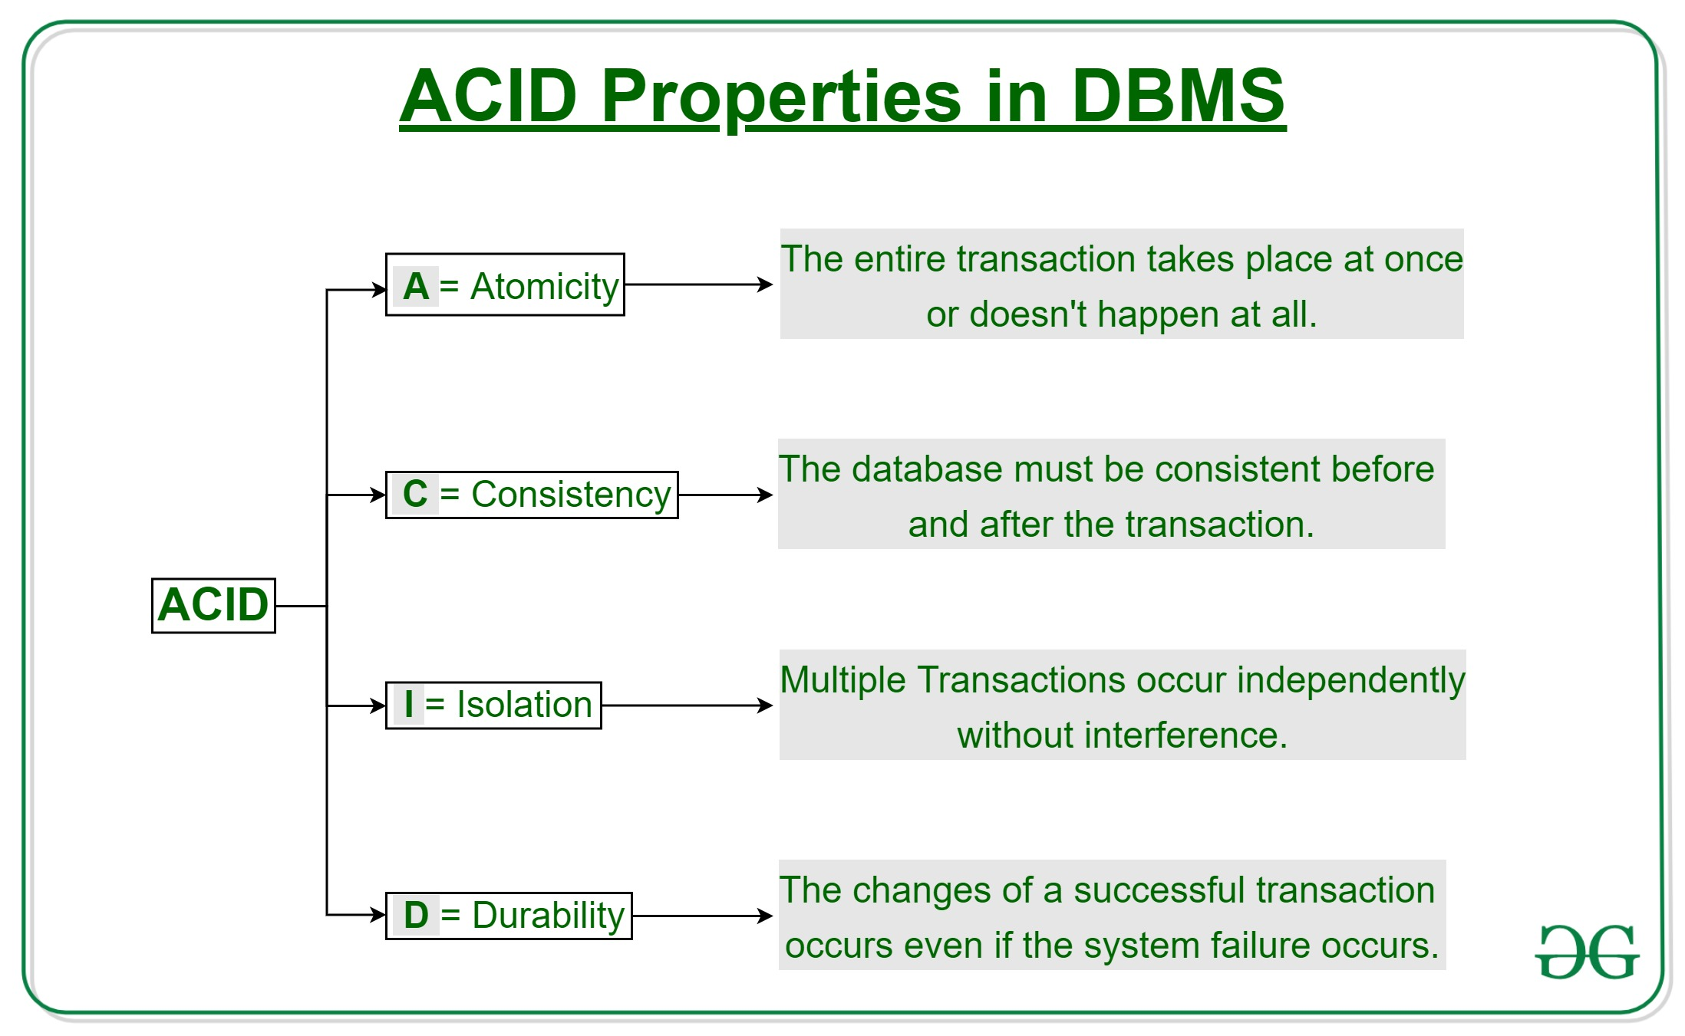
The ACID Test

Slide 13
Transaction Syntax
START TRANSACTION
Do the UPDATE/INSERT/DELETE statements
COMMIT (ends the transaction and saves the changes)
OR
ROLLBACK (ends the transaction without saving the changes)
Transactions happen on the connection. Each application has its own connection(s). The results of a transaction cannot be seen by other connections until it is committed.
Transactions can be used to safely test a statement that changes the database during development/testing.

Slide 14
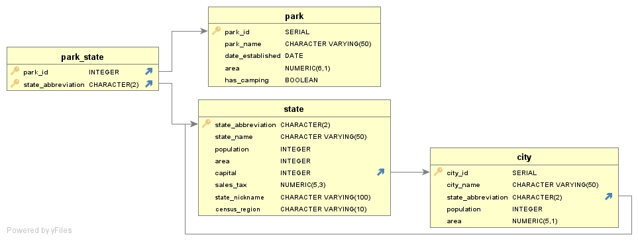
UnitedStatesDB

Slide 15
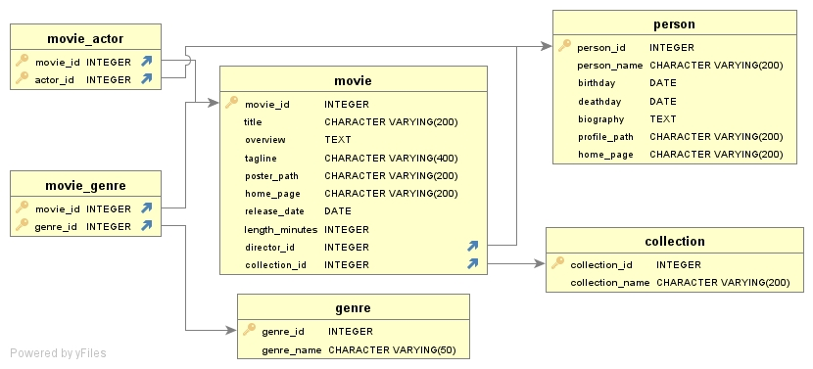
MovieDB

Slide 16
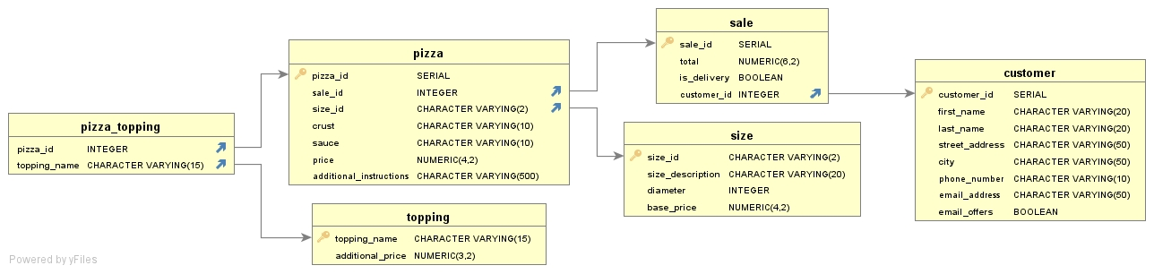
Pizza Shop

